Slide 1
Title
Hi it’s me
Notes:
Thank John for introduction
Title
Lighthearted introduction since they all hopefully know me

Slide 2
Treatment selection & adaptive care for substance use disorders
Gaylen Fronk
University of Wisconsin-Madison
Capstone Presentation
May 4, 2022
Notes:
Hi, I’m going to be telling you today about who I want to be as a clinical scientist, what I want to do within that role, and what I’ve done so far to prepare myself for that path. I plan to leave about 15 minutes at the end for discussion, and I’d prefer you save questions until that time unless you need clarification.
Before I start, I just want to say that I recognize that the current events of the past few days may be weighing heavily on many of us. They have certainly been weighing on me. It has been really hard for me to feel like finalizing this presentation was a worthwhile use of time given this context, and I’d imagine some of you might be feeling the same way about listening to it. Please feel free to have your cameras off so that this hour can be as comfortable as possible for you – or keep them on if a bit of community will help you more - and just know that I really appreciate you being here today.

Slide 3
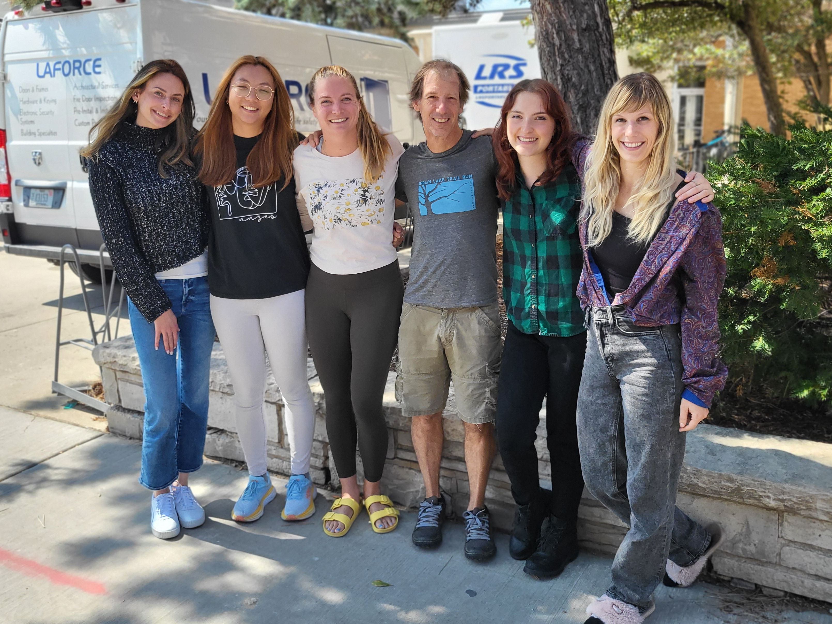
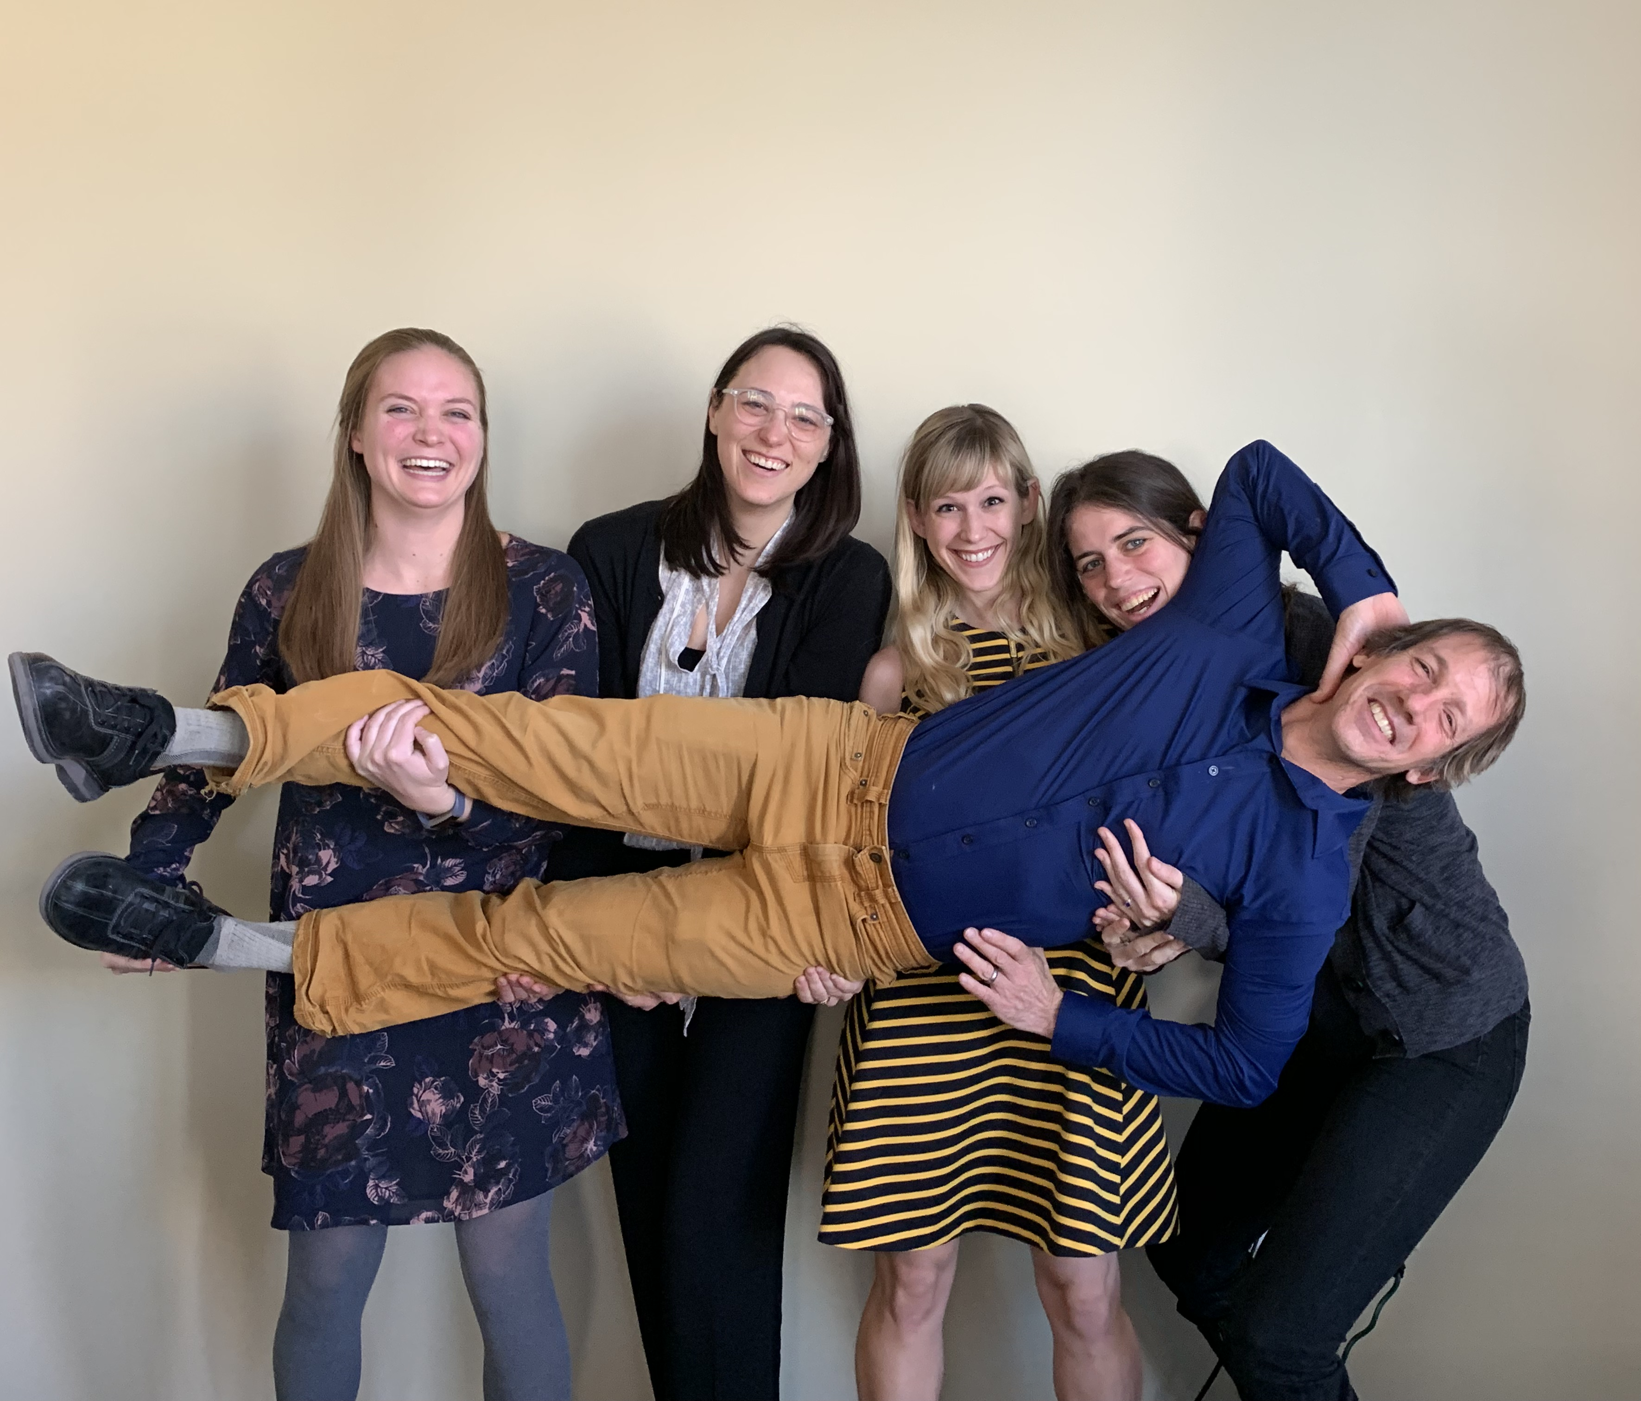
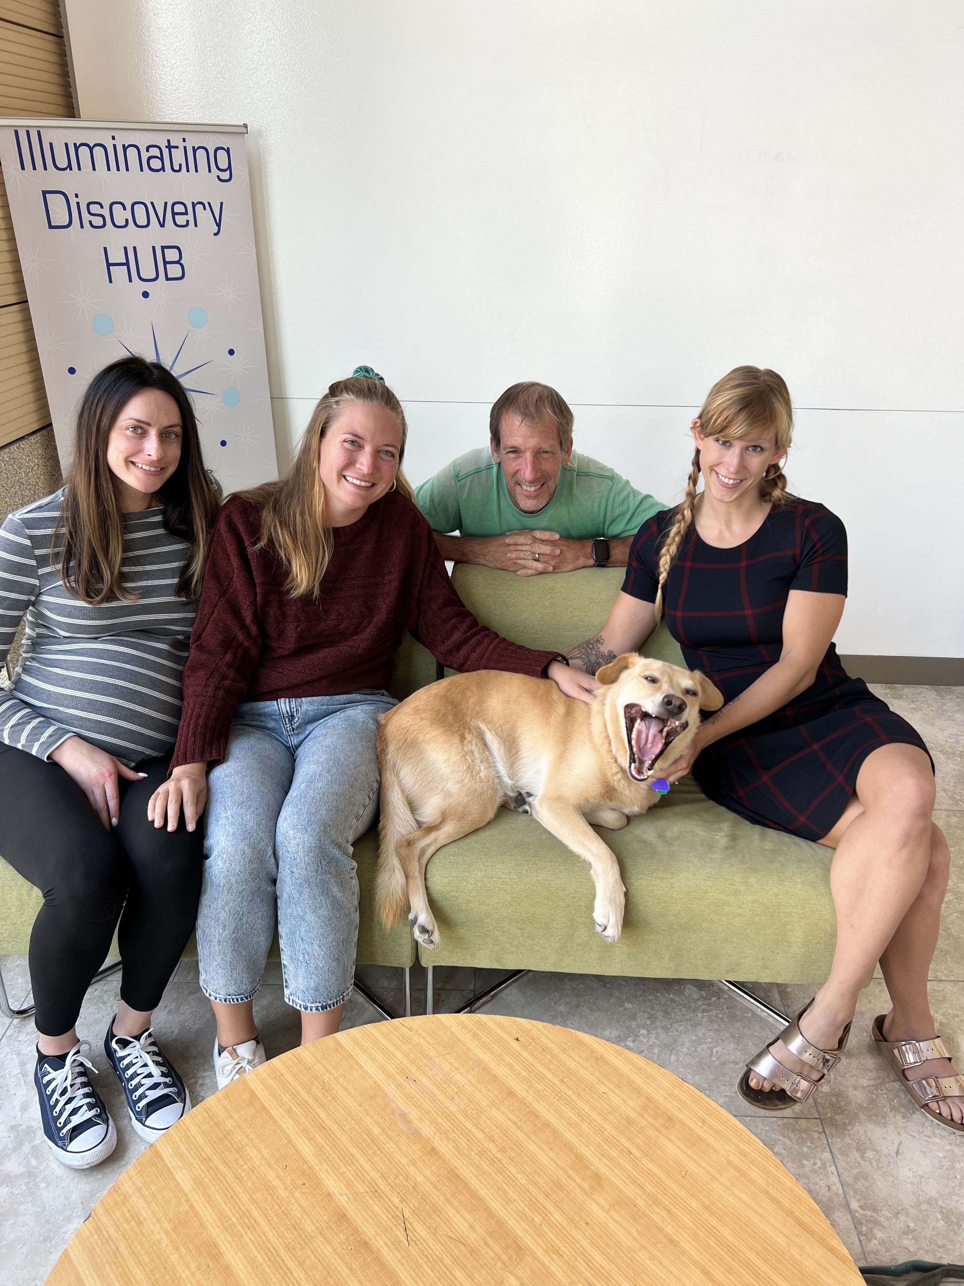
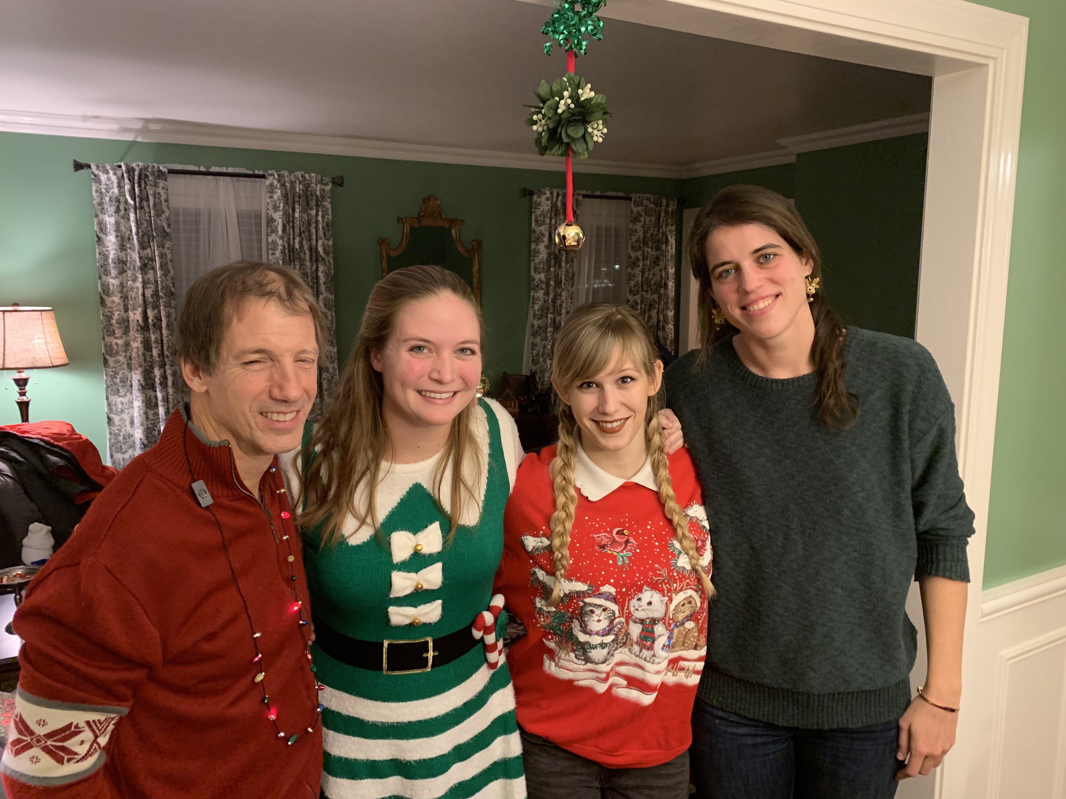
Advisor
Dr. John Curtin
Lab manager
Susan Wanta
Addiction Research Center
Dr. Daniel Bradford
Dr. Jesse Kaye
Dr. Kate Magruder
Dr. Hannah Moshontz
Ariela Papp
Claire Punturieri
Sarah Sant’Ana
Kendra Wyant
Coco Yu
Notes:
Acknowledgements:
I want to thank you all for being here today! I also want to say thank you to a few specific people before we get started
John (in case it wasn’t obvious from that incredibly kind introduction, I have the most wonderful mentor)
Susan (truly would not have finished my dissertation – and likely grad school more generally – without her)
Rest of lab

Slide 4


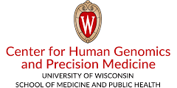

Mentoring Committee
Dr. Craig Berridge
Dr. Linnea Burk
Dr. James Li
Dr. Megan Piper
Dr. Kate Walsh
Funding & Data
Additional Mentors & Supporters
Dr. Jennifer Dahne
Dr. Chris Gioia
Dr. James Lickel
Dr. Mike Messina
Dr. Mark Smith
Dr. Rachel Tomko
Notes:
Acknowledgements:
Mentoring committee, additional mentors & supporters (VA, MUSC, Chris)
CTRI for data
Funding

Slide 5
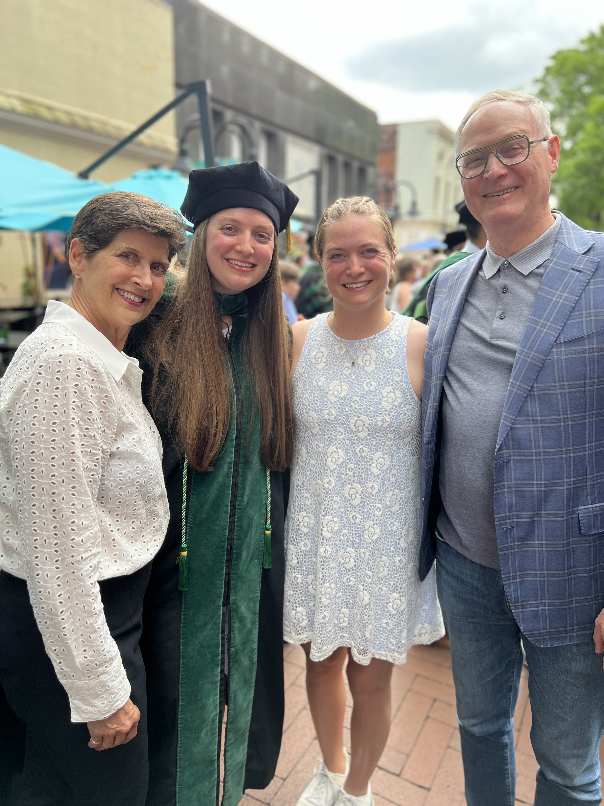
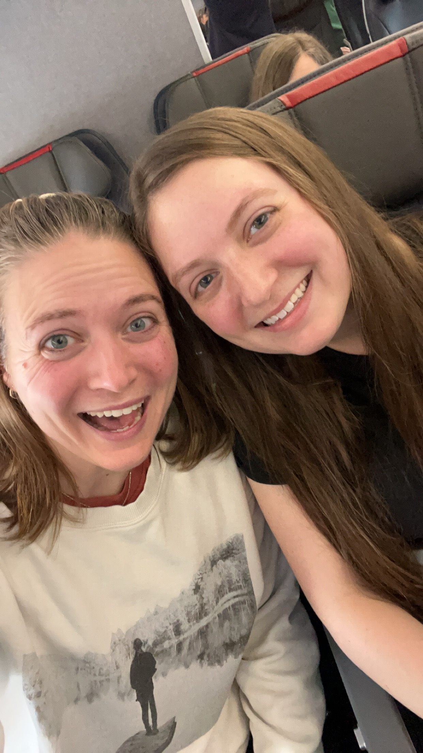
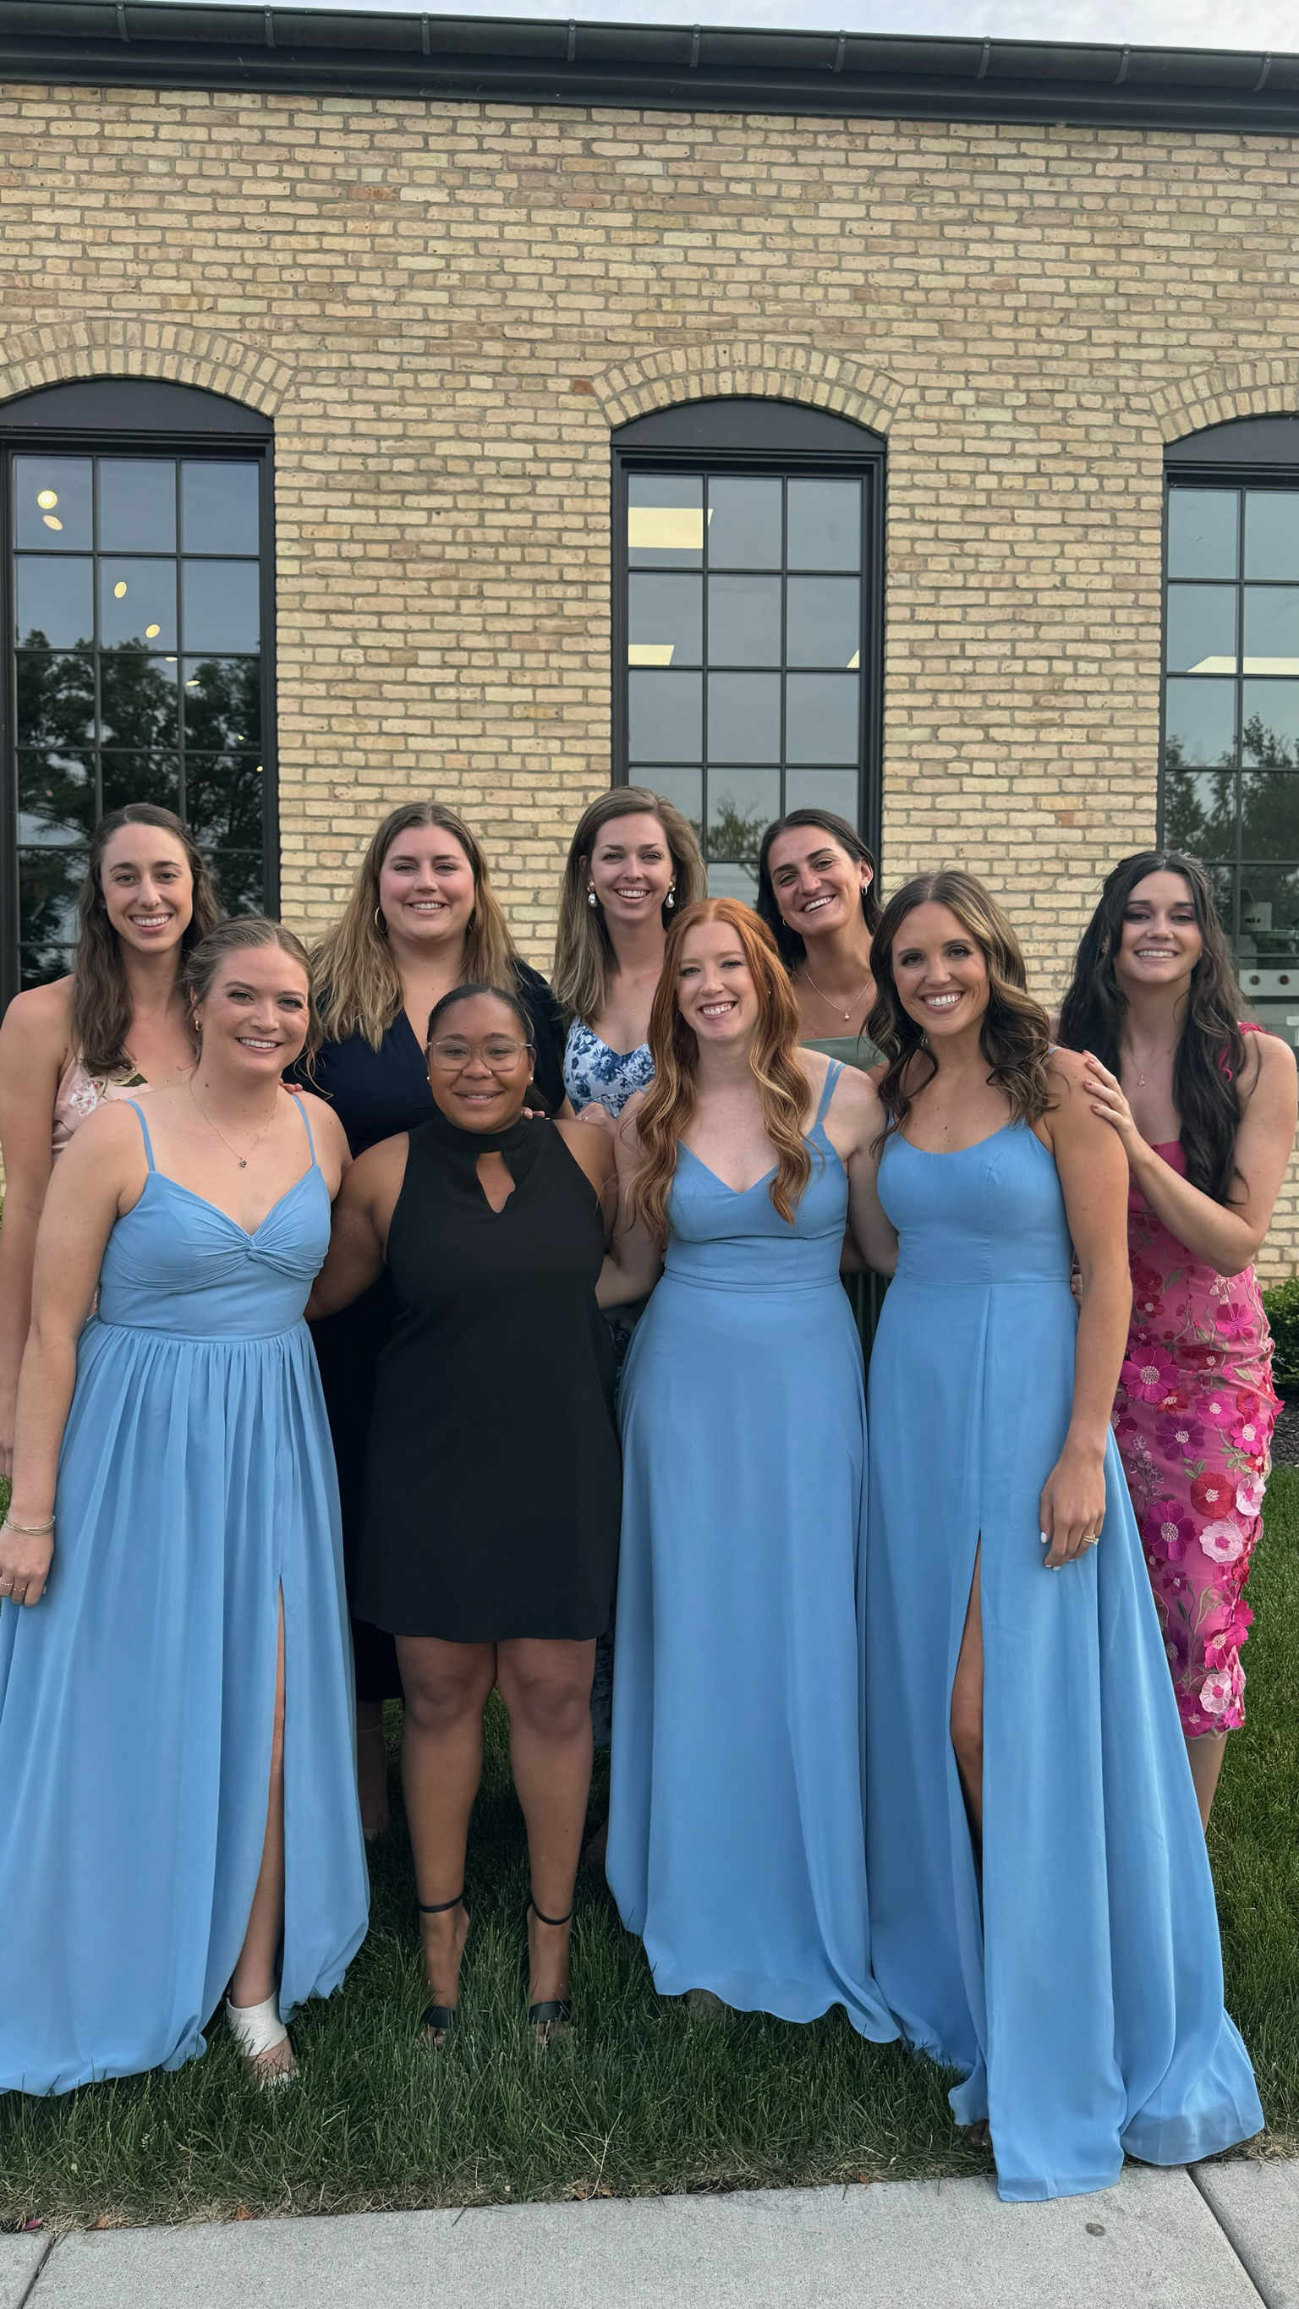
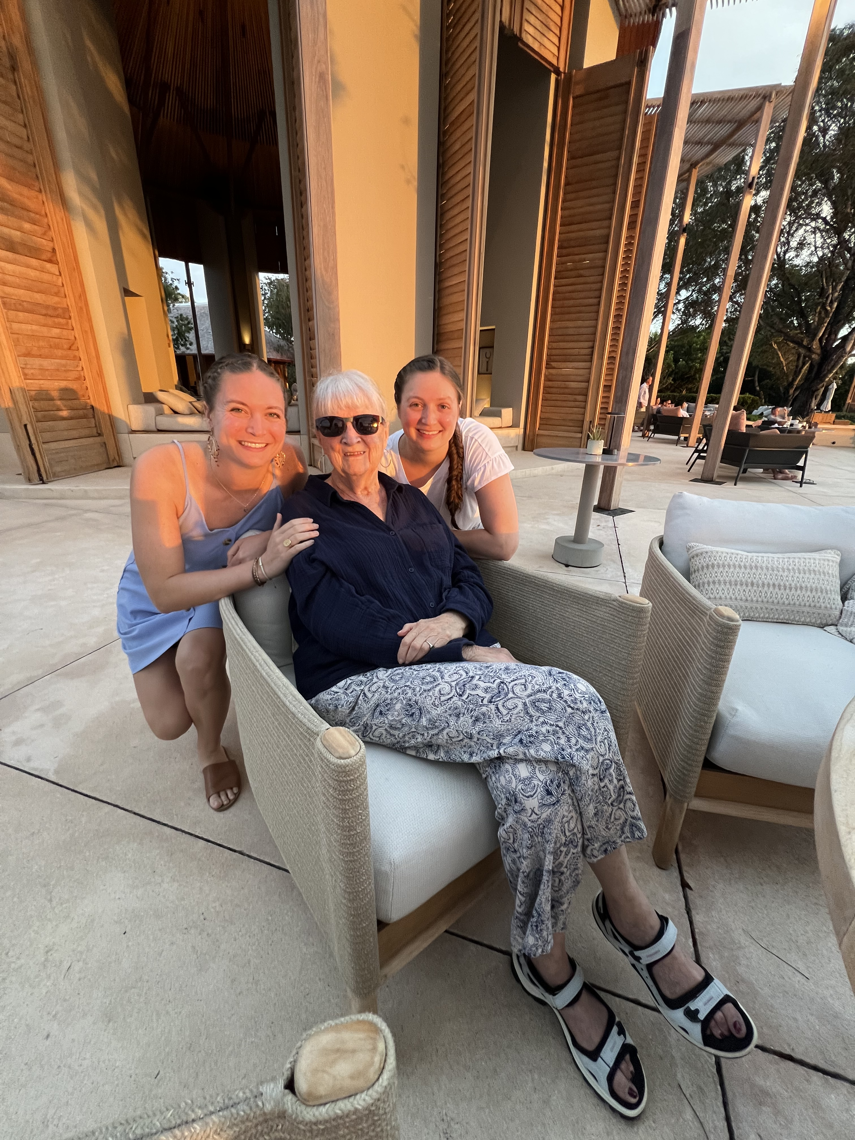
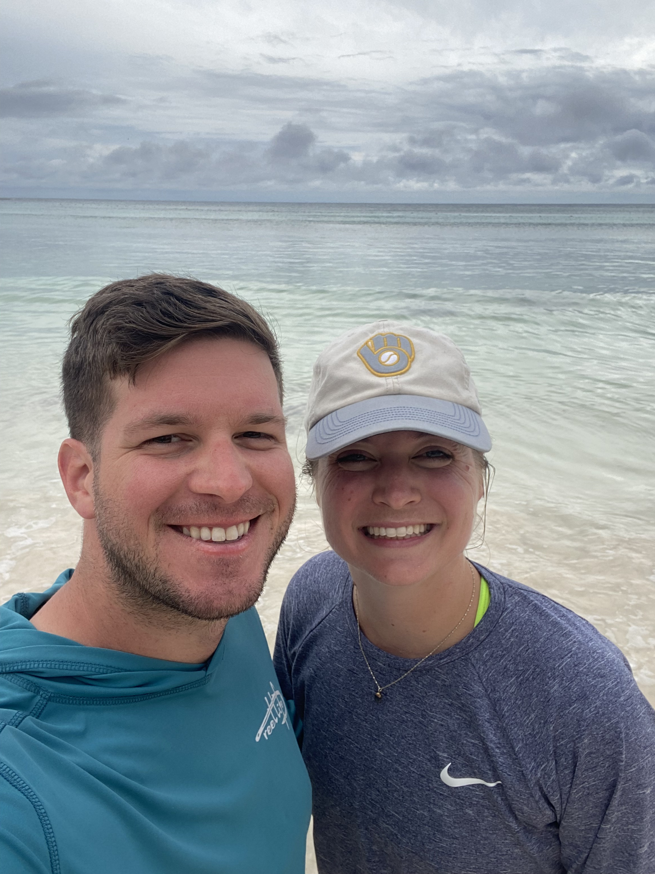
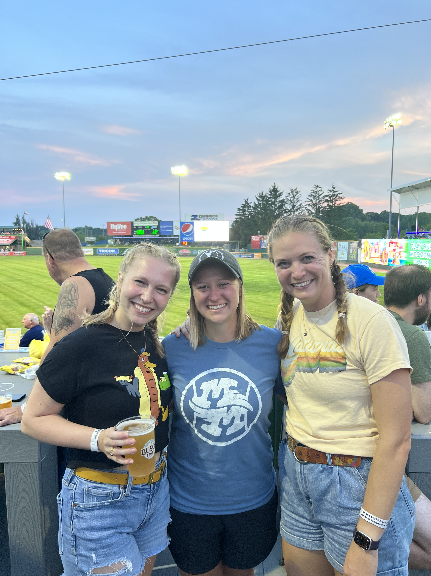
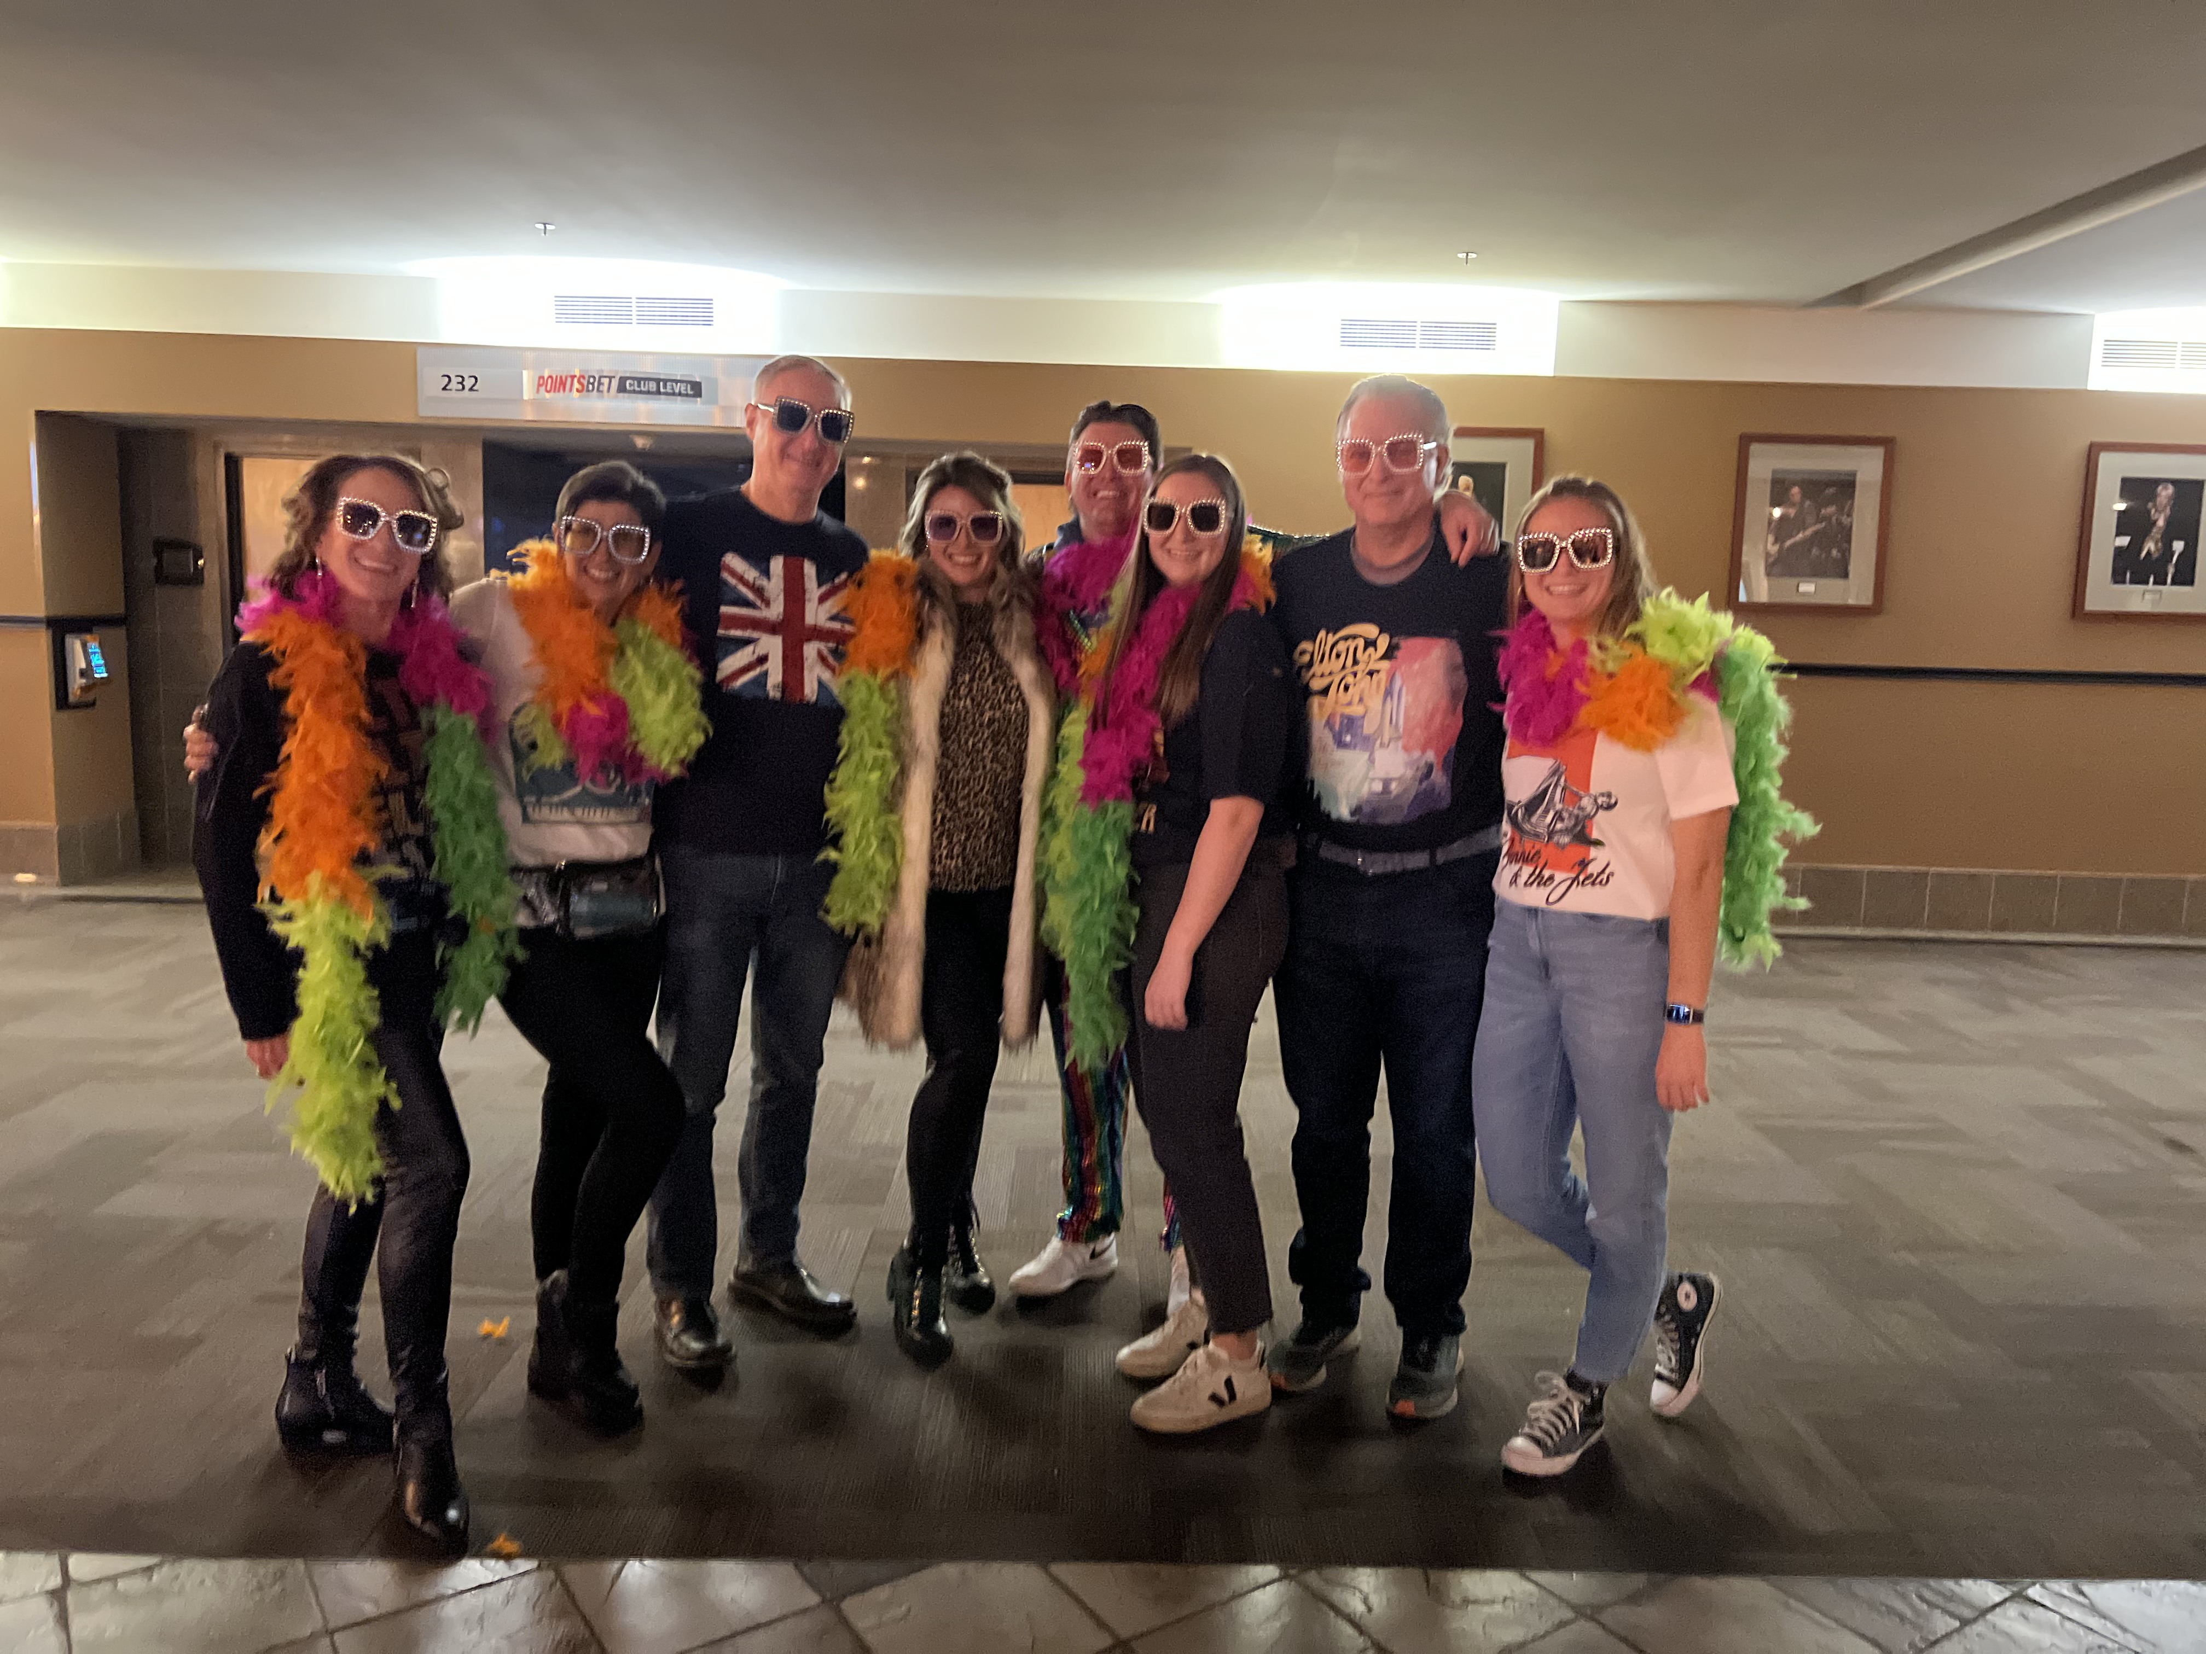

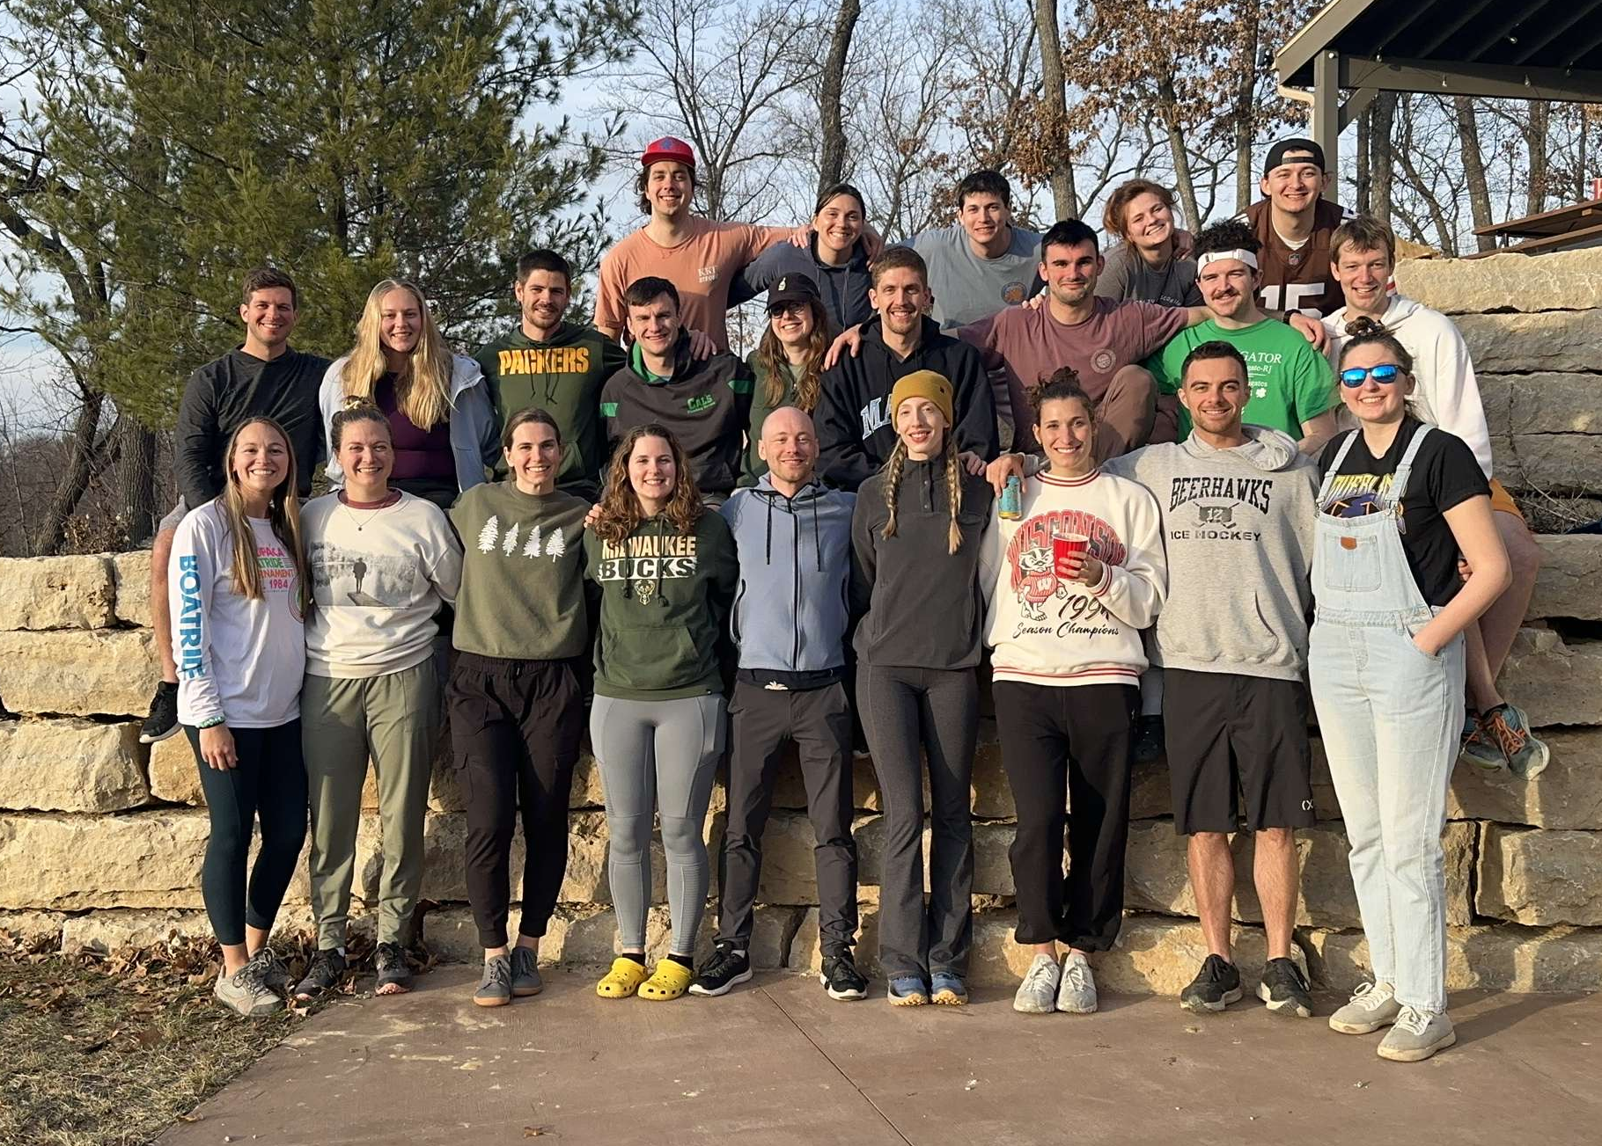
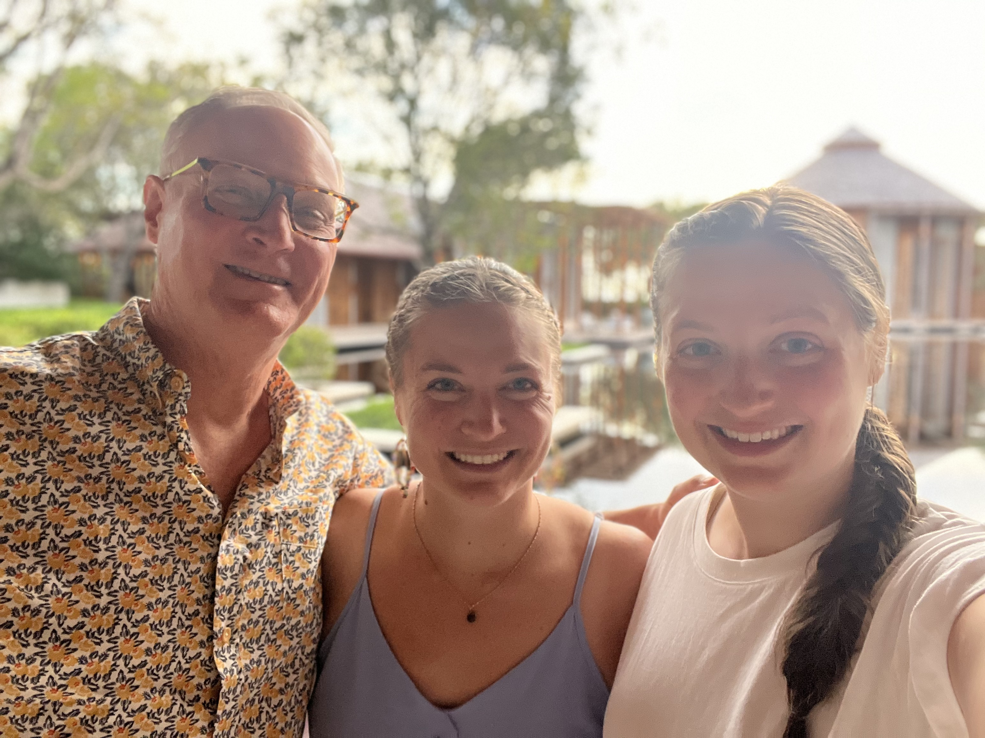
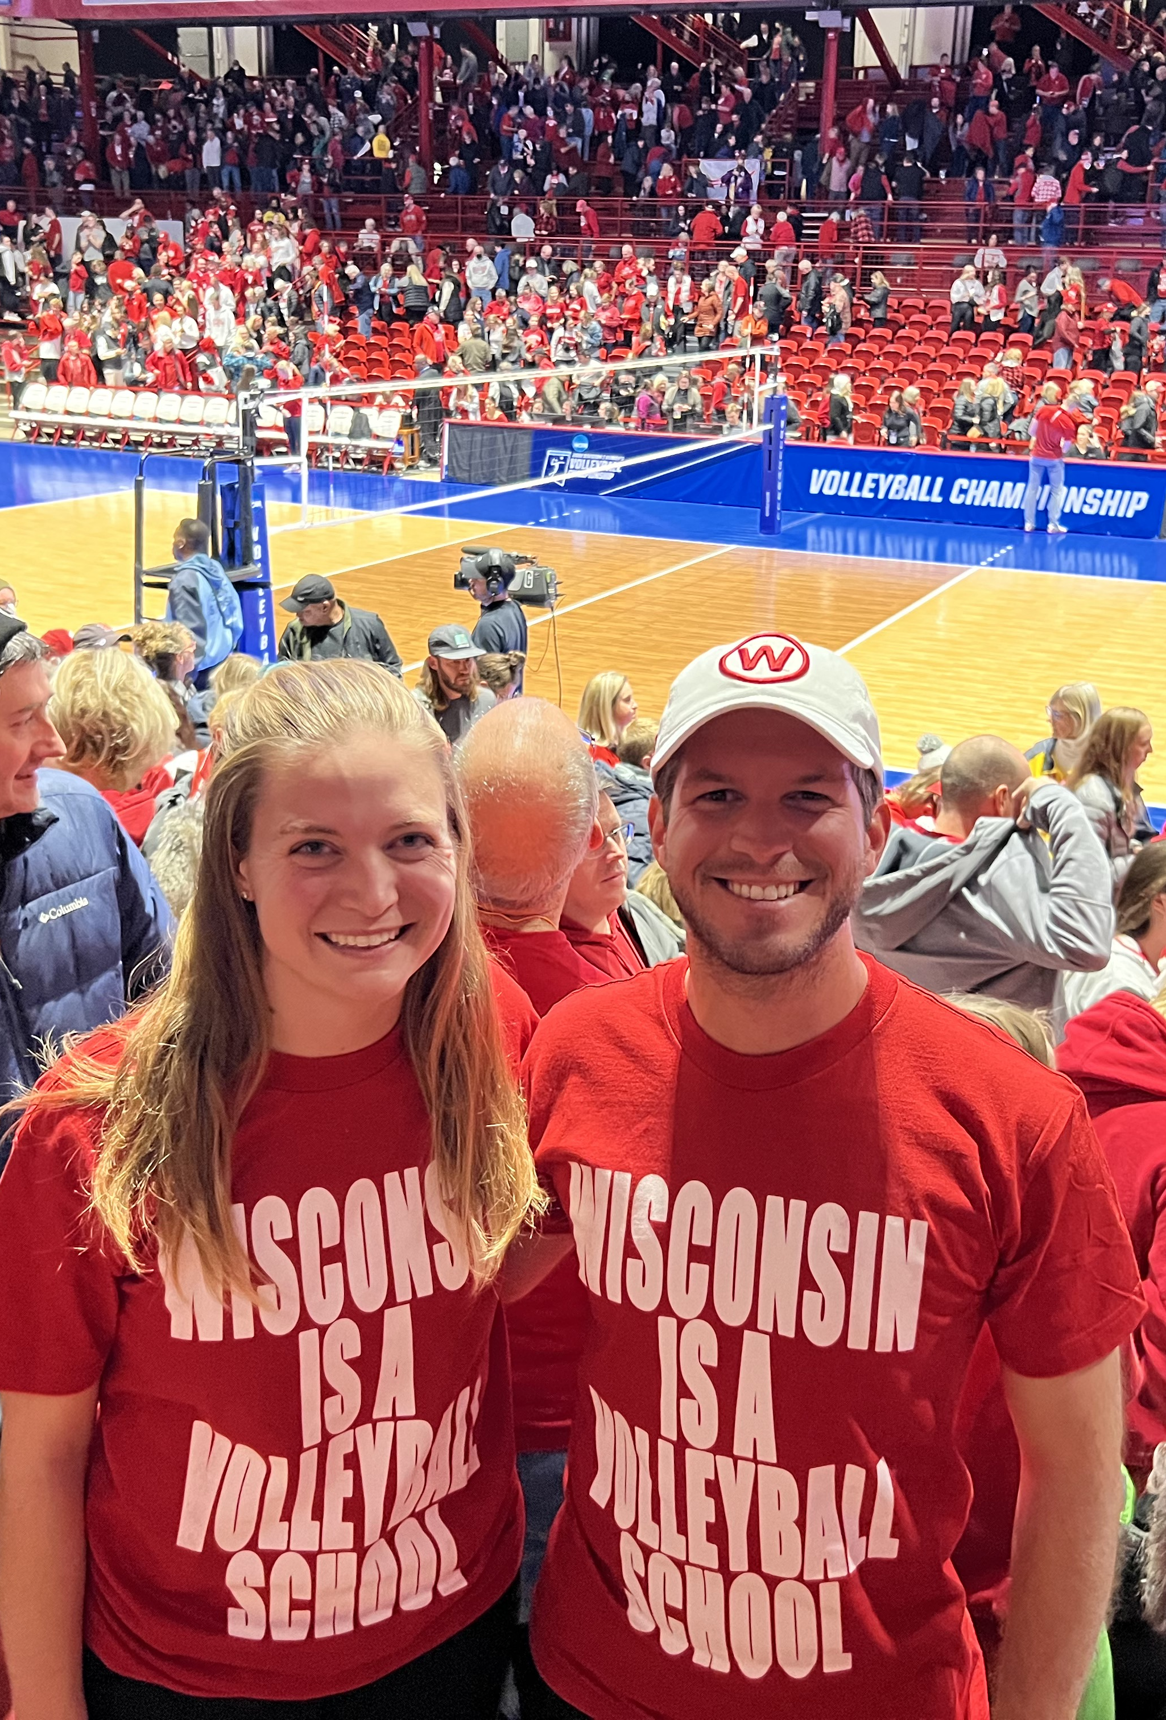
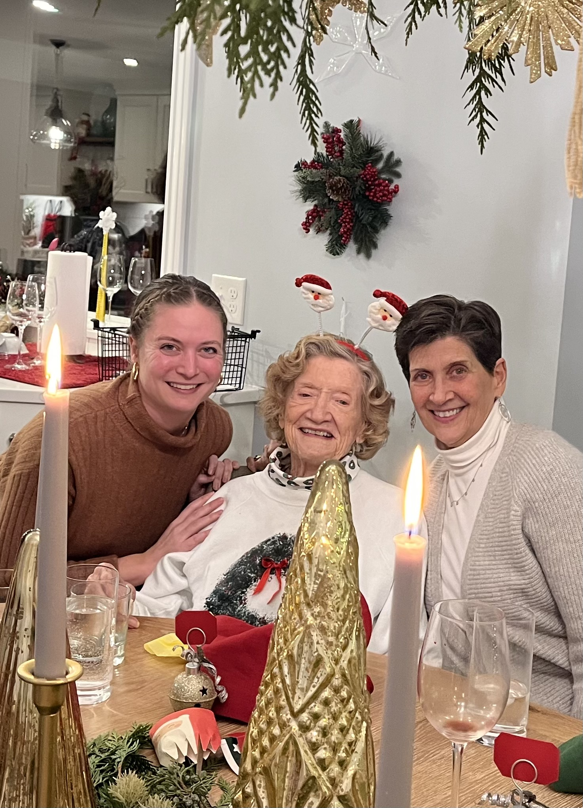
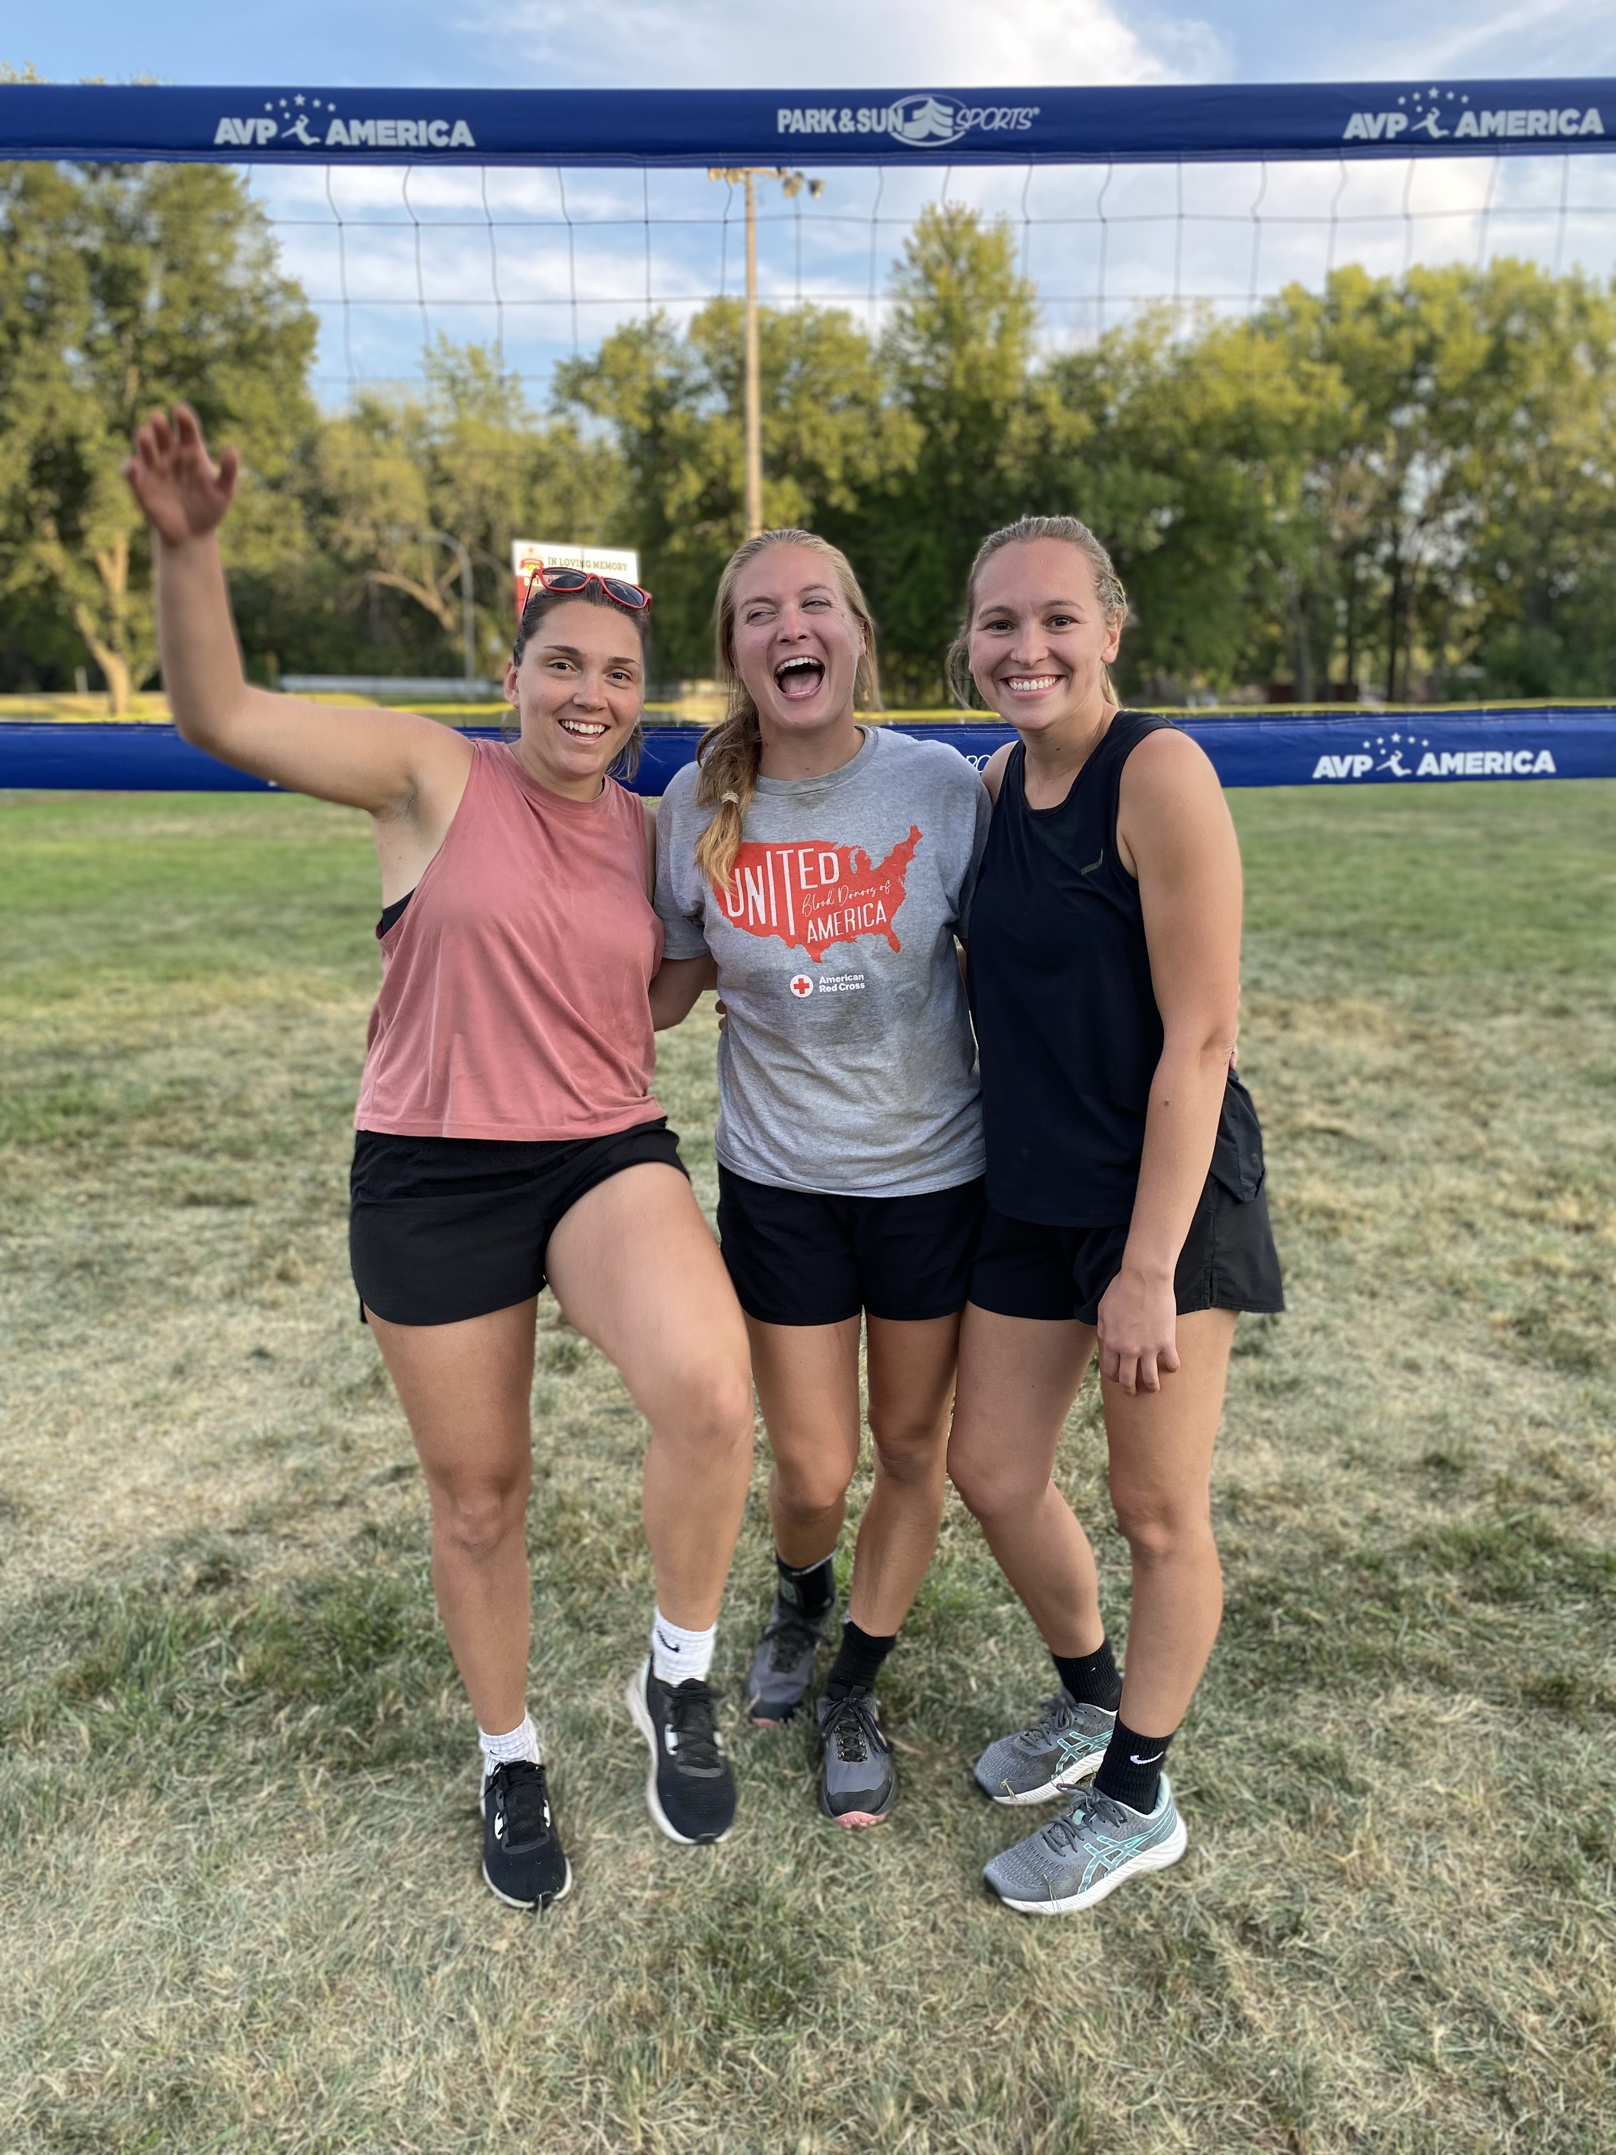
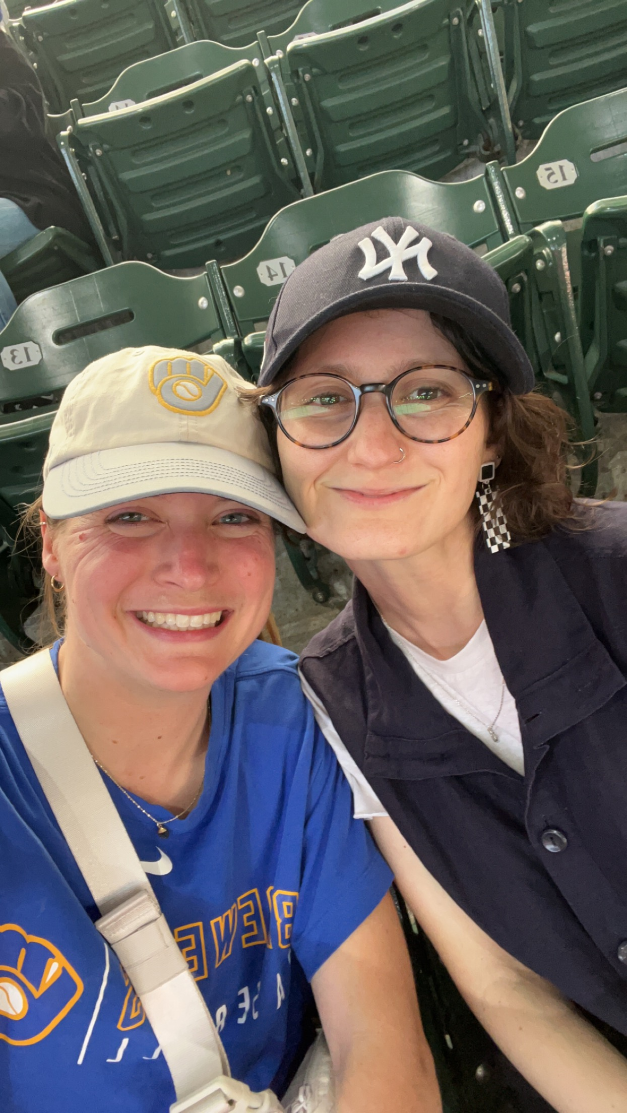
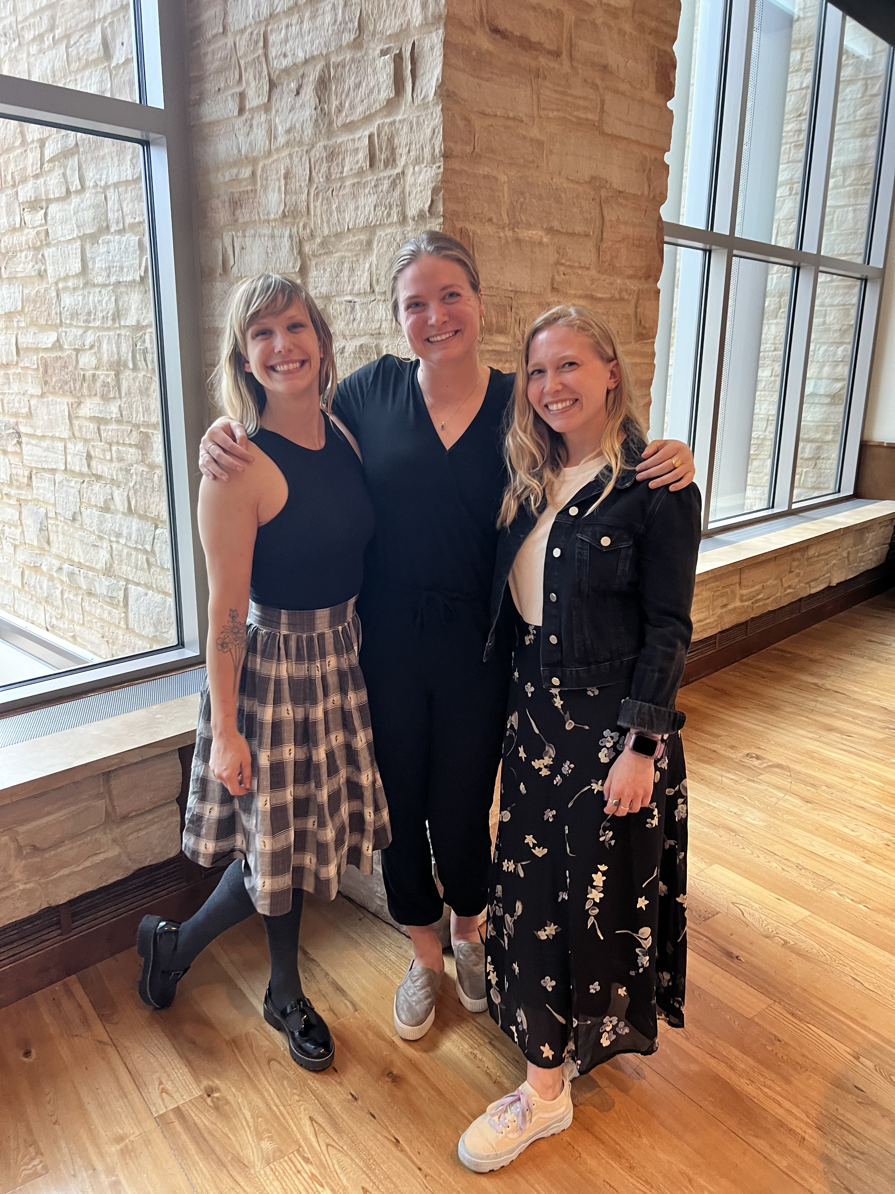
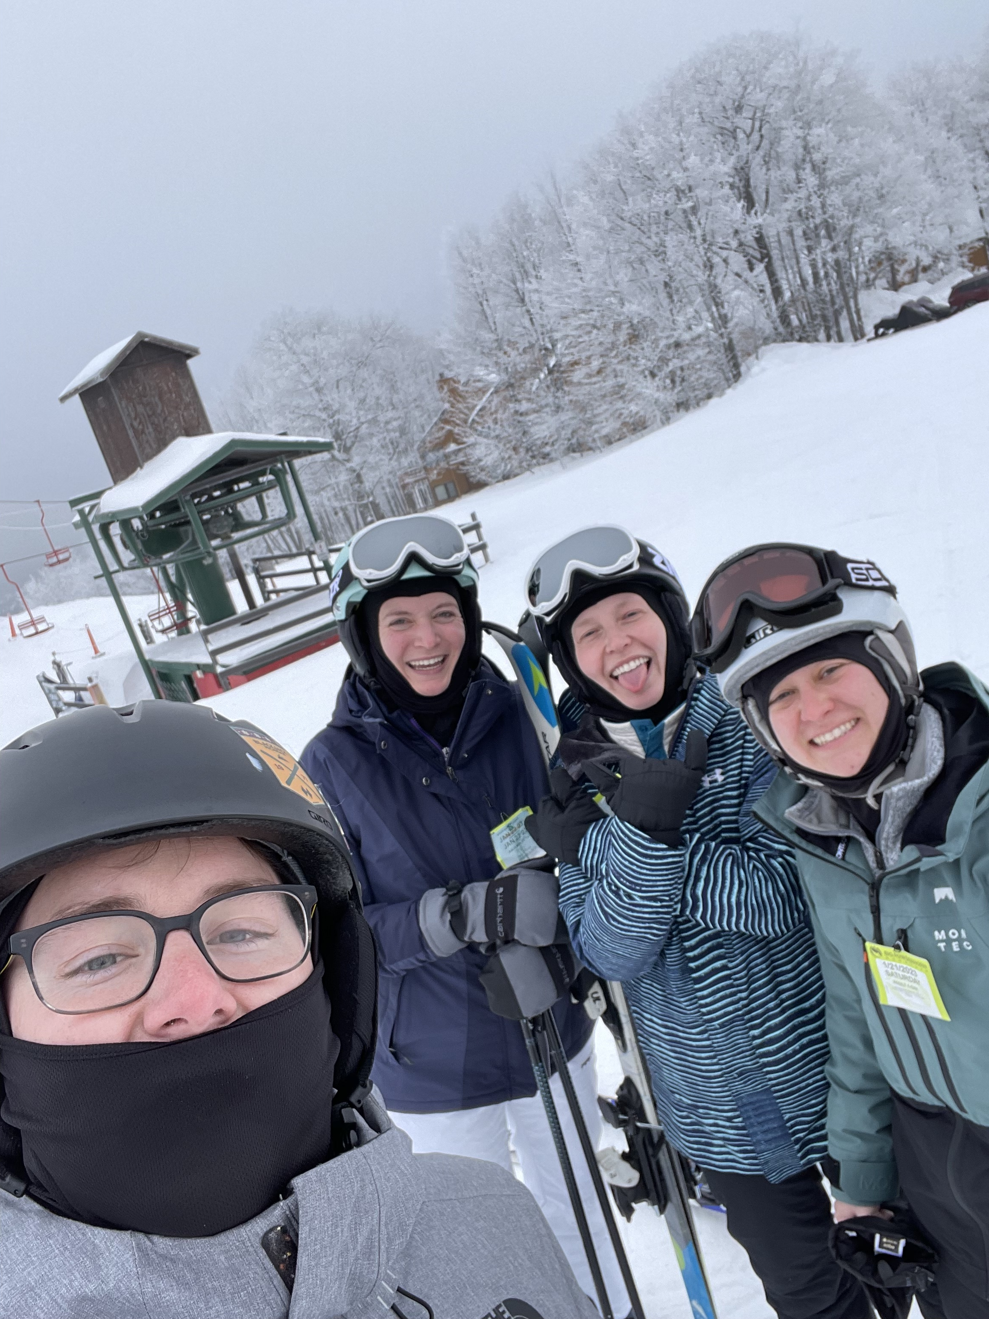
Notes:
Acknowledgements:
Friends & family (Joey, Emily, Mom & Dad, school friends, volleyball friends, DCVB)

Slide 6
Traditional treatment assignment
Treatment A: 75% Effective Treatment B: 25% Effective
Notes:
We can contrast this approach to the way we traditionally assign treatments, which relies on population-level characteristics. Typically, we select a treatment for a patient from a wide variety of available options. Likely, an important factor in your decision will be how effective that treatment is. For example, we’re more likely to select a treatment that works for 75% rather than 25% of people. But if your patient is this person [CLICK], we would have chosen wrong. This illustrates a problem with how we assign treatments in that what works best at a population level does not necessarily work best for the patient sitting in your office.

Slide 7
Notes:
Problem of traditional treatment selection. Work through graphic. 75/25 so that the point can be stronger here and so that I can make the comparison to mental health conditions having comparable tx
Related problem of time & cost of developing new treatments

Slide 8
Notes:
Precision medicine – definition, what it would mean to be successful, why it has advantages for optimizing existing tx and developing new ones

Slide 9
Notes:
Precision med in cancer & tie to genetics

Slide 10
Notes:
Precision mental health – definition, why is it so needed? (costs of MH, disparities, moderate effectiveness, comparable effectiveness [anxiety, ptsd, dep])

Slide 11
Traditional treatment assignment for SUDs
Treatment A Treatment B Treatment C
Notes:
Precision mental health approaches are also particularly important for substance use disorders because of the effectiveness of existing treatments. In the traditional treatment assignment example I presented earlier, using population-level effectiveness won’t work for every patient, but it’s probably a fairly useful first heuristic when the two treatment options are either 75% or 25% effective. In SUDs, however, our treatments are not only modestly effective at best but also similarly effective. Take this example, where we have three treatments with equal, 25% effectiveness. This is a fairly realistic estimate of the scenario a patient or provider might be faced with when choosing a treatment for SUDs. Population-level effectiveness would be unhelpful here. In contrast, selecting treatments via a precision mental health approach could yield much more success.

Slide 12
Notes:
Progress in PMH < PM → why? Less likely to have biomarkers/single genetic targets to help select treatments, complexity of clinical phenomena that require considering many factors at once, fitting models in one sample exacerbates problems

Slide 13
Notes:
There is a need for analysis techniques that can:
Capture sufficient complexity to predict treatment success by considering many features in PMH models
WHILE generalizing well to new patients

Slide 14
Machine learning approaches
Well-suited to overcome previous limitations
Maps onto complexity of people and clinical phenomena
Prioritizes out-of-sample prediction
Notes:
Machine learning is well-suited to overcome many of the limitations of previous precision mental health research. [CLICK] Machine learning models can handle hundreds or even thousands of predictors simultaneously, meaning that they can capture the complexity of patients and clinical phenomena. [CLICK] Additionally, machine learning makes use of methods that prioritize out of sample prediction by fitting and evaluating models in separate data, which aligns better with our clinical science and application goals.

Slide 15
Notes:
Enter: ML! How can this address the needs of PMH research (consider many features simultaneously from multiple domains, prioritize out-of-sample prediction using CV, tools for interpretation)

Slide 16
Notes:
The goal in this project was to develop a machine learning model that could select among treatments for people trying to quit smoking
Why is this important? Public health burden of smoking, adtl burden in vulnerable sub-populations

Slide 17
Notes:
Status of available smoking cessation tx. Be sure to focus on my 3 treatments but also clarify that they are generally the most effective

Slide 18
Notes:
Previous PMH research in the smoking domain
- Lots of research identifying who will or will not be able to quit successfully
Research looking for who will succeed using a single treatment
What are the BENEFITS of this research?
Why are these NOT helpful for our goal of selecting among tx?
Two columns – existing research in one and why it isn’t helpful in the other. Consider putting biomarker/genetic work and single moderator studies on this slide too

Slide 19
Notes:
Optimism! Why I think there is hope here! → opportunities for differential tx selection. VERY DIGESTIBLE EXAMPLES of different drug mechs, behavioral/environmental examples in conjunction with my meds

Slide 20
Notes:
Goals of the project
Build a treatment selection model
See if it helps people

Slide 21
Notes:
Data (multiple slides)
Data source CTRI
Participants (sample characteristics here, format like Kendra/John graphic)
ID characteristics
Don’t talk about outcomes at all yet → flow into next slide about these data become model inputs. No mention of later outcomes until aim 2

Slide 22
Notes:
AIM 1 METHODS (MULTIPLE SLIDES)
Basic overview of model inputs (features) & outputs (4-week treatment success prediction outcome)
What happens between the inputs & outputs? That’s the model. Describe statistical algorithm re: why it matters
DO NOT DESCRIBE feature engineering, different feature sets, model configurations generally, hyperparameters, dimensionality reduction other than GLMNet
IMPORTANT talk about interactions with treatment
Cross-validation – important elements & what you need to know / why it matters
Metric auROC (maybe on same slide as CV)

Slide 23
Notes:
Model performance auROC
Bayesian CI around performance to establish there is signal
Model calibration
Interim takeaways – model has signal, matches some existing research, ~70% chance that our model correctly assigns a higher probability to a positive (abstinent) case than a negative (smoking) case, considered “acceptable”

Slide 24
Notes:
Now we have a model that predicts treatment success overall – which puts us in the same position as some of that previous research. Overall prediction was NOT our primary goal. Capturing some signal with our model was necessary for us to trust our predictions, but it’s insufficient. A model that predicted treatment success PERFECTLY but included no interactions would be useless for treatment selection. But our model did include interactions, YAY!
New slide – model interpretation (# interactions retained, walk through what an interaction “means”, give an example of one that pushes people in different directions?, list most important features in plain English)
We want to take this to the next step and find out how we can use it to select among treatments → reminder of AIM 2

Slide 25
Notes:
AIM 2 METHODS (multiple slides)
Identify model-predicted best treatment
Categorize treatment matching
WALK THROUGH VERY EXPLICITLY AND SLOWLY WITH AN EXAMPLE

Slide 26
Notes:
Evaluate clinical benefit, describe analysis clearly but briefly. Don’t mention Bayesian. Talk about multiple time points for assessment outcomes here

Slide 27
Notes:
AIM 2 results – figure 4 from paper. Walk through very slowly

Slide 28
Notes:
Takeaways
Our treatment selection model can offer immediate benefit to people looking to quit smoking using several first-line medications – contextualize what effect size (percentage difference) means
We can achieve this benefit using an assessment that is low-burden and accessible (50ish multiple choice and yes/no items, would take about 10 minutes for someone to complete). Could be remote bc all self-report

Slide 29
Notes:
Takeaways continued
It is important to select a treatment that can offer improved success during initial recovery!!

Slide 30
Notes:
Why might our model not offer benefit in the long-term?
We think the most likely possibility is that many of the features used in this model were based on single assessments of current states (e.g., what’s your withdrawal like RIGHT NOW?). It may be that these features do predict ongoing treatment success, but because the features themselves change dynamically over time, what was the right treatment based on pre-quit characteristics is no longer the right treatment by 12 weeks, 6 months, or beyond
Example of feature that indicates someone lives alone or only with their partner. This same feature increases success using C-NRT and decreases success using varenicline. What if this was an important factor that led to C-NRT being selected as an individual’s best treatment – and then they move?

Slide 31
Notes:
Examples like these are the rule rather than the exception for CHRONIC, RELAPSING DISORDERS like SUDs
Consider diabetes – we know that it’s not your average blood glucose levels that matter, or a measurement from 4 weeks ago – what matters is your CURRENT blood glucose level. So we monitor it continuously, because if it’s low RIGHT NOW you need to eat or drink something with sugar. If it’s high RIGHT NOW, you need to take fast-acting insulin
Tobacco and other substance use disorders are the same way. They are dynamic – both risk for use and the factors driving that risk fluctuate over time

Slide 32
Substance use disorders as chronic diseases
Review
Continuous monitoring (“sensing”)
1st Tx
Adaptive continuing care
Drug use
Time
Notes:
Adaptive continuing care requires two things. First, it necessitates assessment. This assessment includes retrospective review of a person’s history leading up to their initial treatment selection as well as subsequent, nearly continuous monitoring of characteristics that might affect and predict increased risk for an upcoming lapse back to substance use. These characteristics of both the individual and their environment must be measured with high temporal precision. Often, this continuous, high-resolution monitoring is called “sensing”. Our lab has begun to do this work with individuals recovering from alcohol use disorder and with individuals recovering from opioid use disorder. The goal of those trials is to build risk prediction models using personal sensing techniques to monitor patient characteristics and lapses back to use during the first 3-12 months following quitting.
Second, following initial treatment selection, adaptive continuing care requires being able to select or suggest treatments over time as risk for lapse or relapse changes. This approach incorporates the understanding that the “right” treatment for a given person can change over time as circumstances change. This could include selecting a new traditional treatment if initial treatment selection was ineffective, suggesting booster modules over time, titrating medication doses, and providing brief/just-in-time treatments built into digital treatment platforms, among others. Thinking back to our examples, these two escalations in substance use severity were for different reasons and may have produced distinct consequences. In one case, the individual may benefit from more intensive SUD-focused care and suggestions of social supports/groups they could join in their new location. In the other, several sessions of mindfulness provided via a digital therapeutic app could be sufficient to help the individual process their grief. Continued care also involves knowing the periods in which a patient doesn’t need as much treatment or support because their risk is low. This helps avoid burnout for that patient and helps to allocate limited resources to patients who need more support. Just as we saw with varying trajectories prior to initial treatment selection, lifelong presentations differ between patients.
Thus, individuals with SUDs all require continuing care, but this care must be adaptive because the specific treatment required not only differs between individuals but also changes within an individual over time.

Slide 33
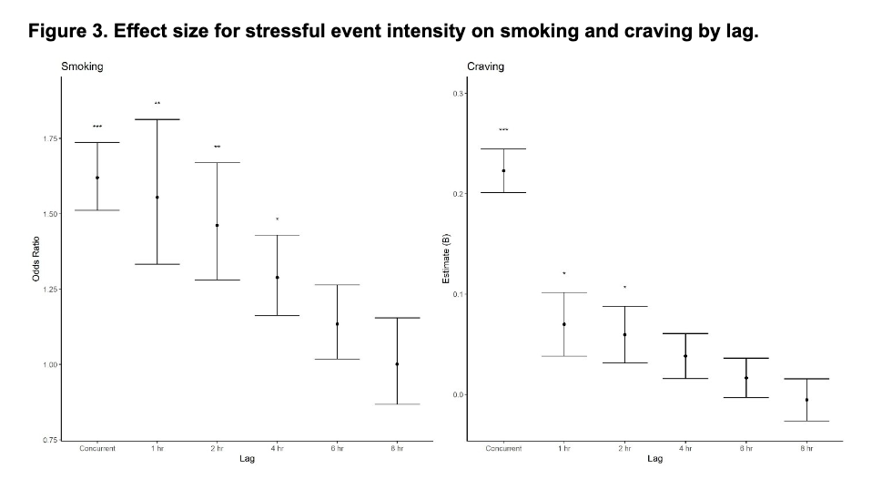
Effect of stressors on smoking & craving
Relationship between stress and drug use/craving varies over time
Journal of Psychopathology & Clinical Science, 2021
Notes:
We can see that effect of lag between stress and smoking/craving more clearly here where you’re seeing the effect size at each lag for smoking (left) and craving (right). The effect of stressful events on both smoking and craving decreased as the lag between reports increased. Smoking and craving were more likely to occur within the first few hours following a stressful event; by 4-6 hours post-stressor, there was no longer a significant effect of the stressful event on either smoking or craving.
These analyses provide strong evidence that stressful events precede both cigarette smoking and craving, supporting one of the core theses of our review paper. They also show the time-varying nature of these effects – even this relatively coarse measurement over time helped to elucidate time-varying effects; continuous sensing could show us even more.

Slide 34
Notes:
So, though it’s important, initial treatment selection is insufficient. We need long-term, continuing care. What does this require?
1. Ongoing assessment of key factors that predict treatment success
2. Treatment selection that can adapt over time

Slide 35
Notes:
Future directions: Prospective clinical trial

Slide 36
Notes:
Conclusion takeaways to leave on-screen during Qs

